Slide 1
Lariat Rent A Car
Finding Insights and Analysis by Uma Sahu

Slide 2



Introduction
Lariat is a national rental car company.
4000 Cars 50 Branches
81.3K Rentals

Slide 3
Business Objective
Lariat’s business objective is to make better business decision by
minimizing costs and maximizing revenue for the company.

Slide 4
Baseline Analysis of Lariat for 2018
Total cost: $33,076,688.64
Gross revenue: $52,830,207.00
Net revenue: $19,753,518.36

Slide 5
Strategy 1
Adding 10% extra cars to maximize the revenue.
Total cost: $36,384,357.50
Gross revenue: $58,113,227.70
Net revenue: $21,728,870.20
In strategy 1 the net revenue/profit is $1,975,351.84 more compared to baseline net revenue.

Slide 6
Strategy 2
Increase the rent by 10%.
Total cost: $33,076,688.64
Gross revenue: $58,113,227.70
Net revenue: $25,036,539.06
In strategy 2 the net revenue/profit is $5,283,020.70 more compared to baseline net revenue.

Slide 7
Strategy 3
Adding 10% extra cars and increase the rent by 10%(combine Strategy 1 and strategy 2)
Total cost: $36,384,357.50
Gross revenue: $63,396,248.40
Net revenue: $27,011,890.90
In strategy 3 the net revenue/profit is $7,258,372.54 more compared to baseline net revenue.

Slide 8
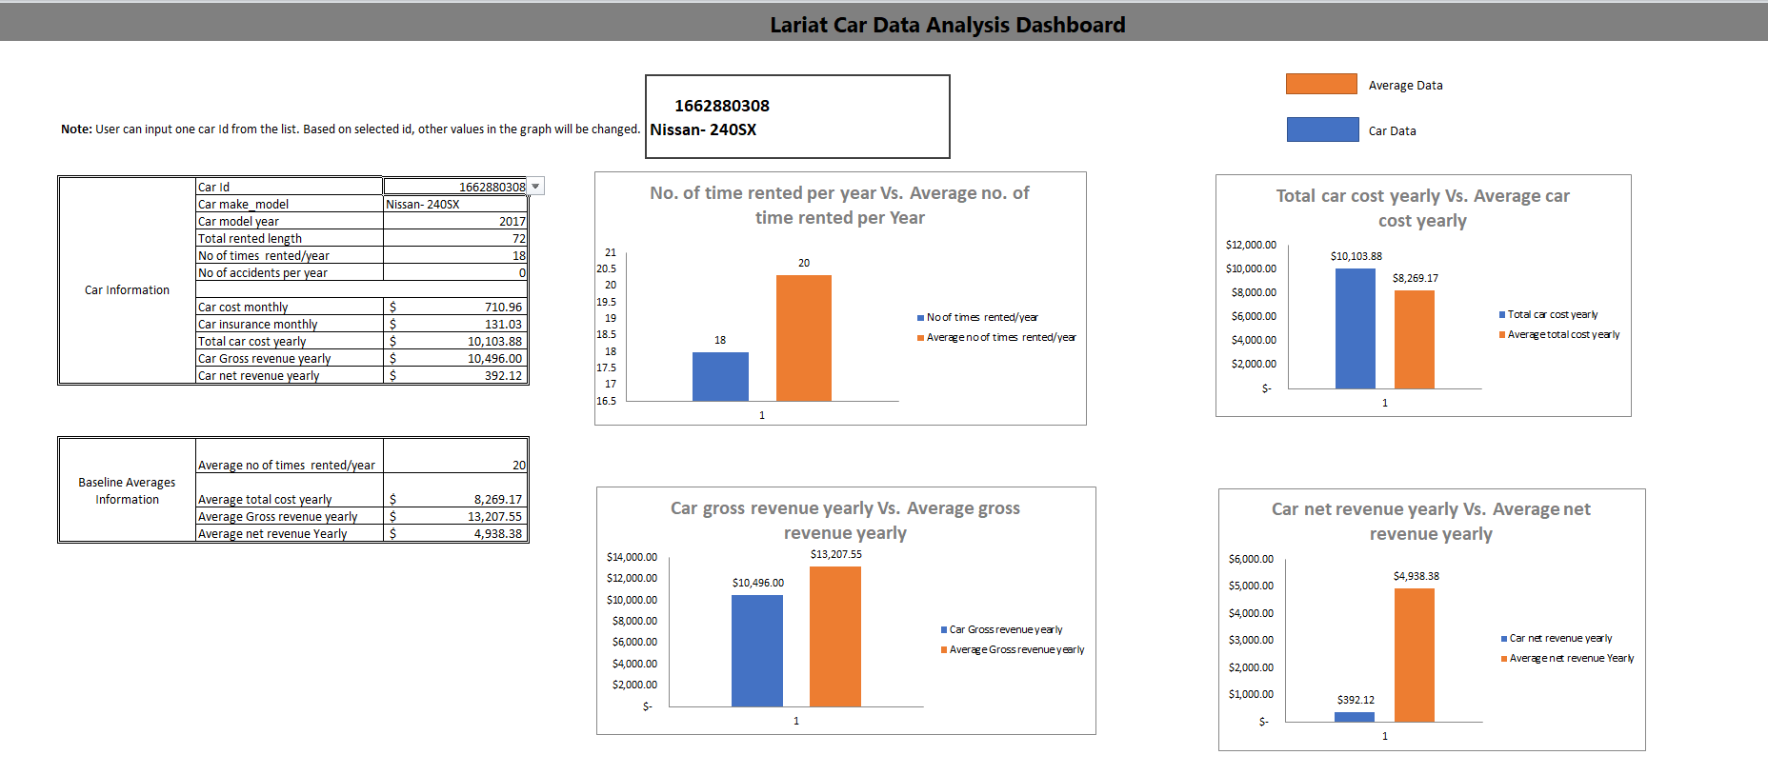
Additional Insights

Slide 9
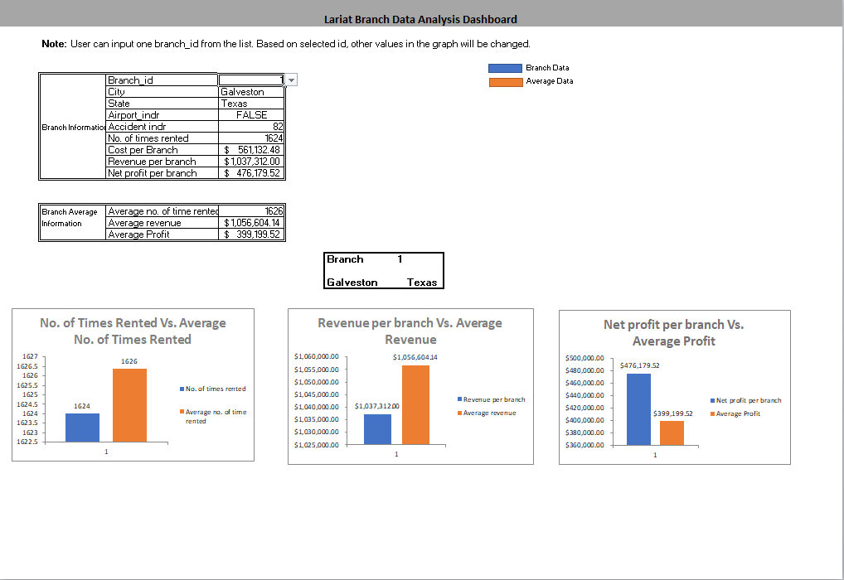
Additional Insights

Slide 10
Summary
Lariat had a net revenue of $19.7M in 2018.
Below is the strategy summary for all the three strategies.
To achieve the Lariat’s business objective, I recommend strategy 3/main goal as in this strategy the total cost remains same as strategy 1 but the net revenue is $27,011,890.90, which is more compared to any other strategy.

Slide 11
Thank you for your time

